Slide 1

🎉 Array Party
Essential Array Methods in JavaScript Understanding
.map(), .filter(), .reduce(), .sort(), and .reverse()

Slide 2
Introduction to Array Methods
Non-Mutating Methods
Mutating Methods
⚠️ Create new arrays
⚠️ Change original array
.map()
.sort()
.filter()
.reverse()
.reduce()

Slide 3
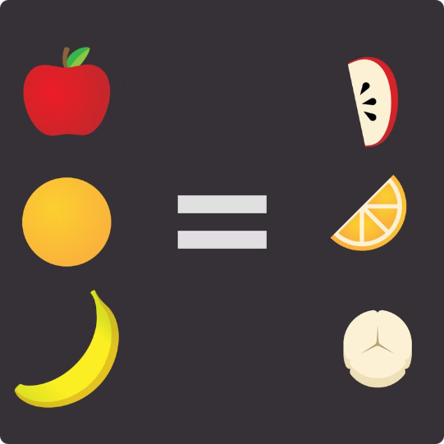
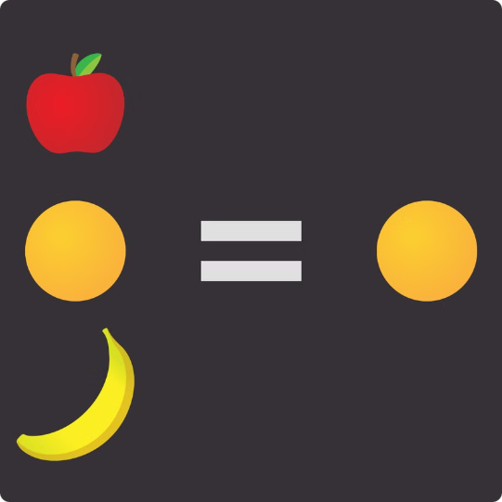
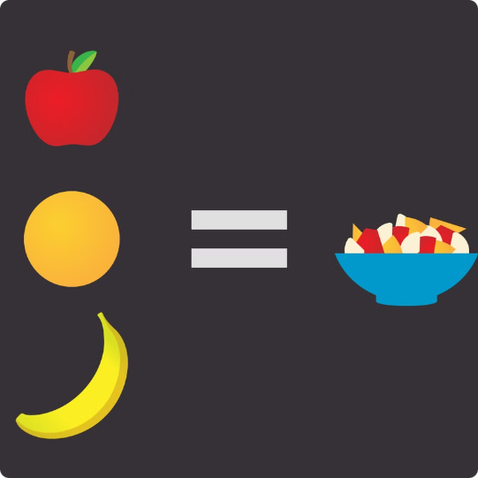
Non-Mutating Methods
Create new arrays
.map()
.filter()
.reduce()
Transforms each element
Selects elements that match condition
Combines elements into single value

Slide 4



.map() Method
Input Array
Callback Function
New Array
[2, 4, 6]
elm => elm * 2
[4, 8, 12]

Slide 5
.filter() Method
Original Array
Condition
Filtered Array
[2, 4, 6]
elm > 2
[4, 6]

Slide 6
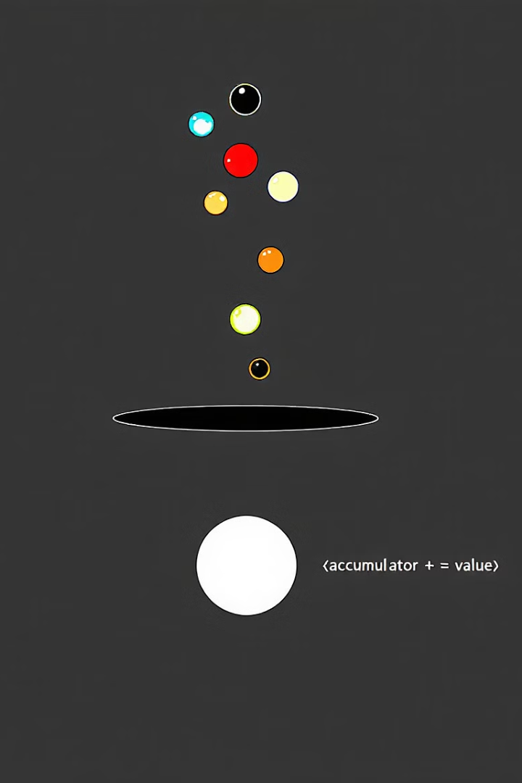
.reduce() Method
Array
1
array = [2, 4, 6]
Start
2
acc = 0
First Iteration
3
acc = 0 + 2 = 2
Second Iteration
4
acc = 2 + 4 = 6
Final Result
5
acc = 6 + 6 = 12

Slide 7

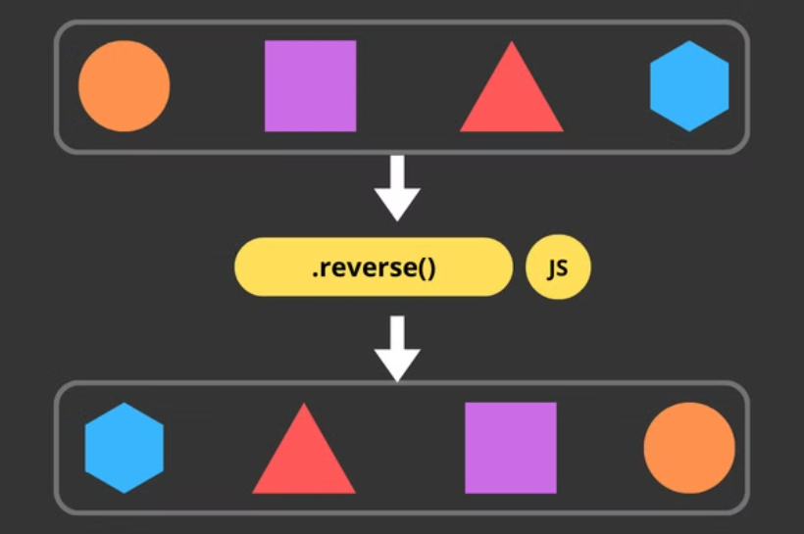
Mutating Methods
.sort()
.reverse()
Reorders elements
Flips element order

Slide 8
.sort() Method
Default Sort
Ascending Order
Descending Order
Alphabetical (Unicode)
With comparator → a - b
With comparator → b - a
[].sort()
[].sort(a,b) => a - b
[].sort(a,b) => b - a
['B', 'C', 'A'] → ['A', 'B', 'C'] ✅ [12, 110, 2] → [110, 12, 2] ❌
[12, 110, 2] → [2, 12, 110]
[12, 110, 2] → [110, 12, 2]

Slide 9
.reverse() Method
Original Array
Reverse
Reversed Array
[2, 4, 6]
[2, 4, 6].reverse()
[6, 4, 2]

